Slide 1

Python Data Types
Understanding the Building Blocks of Python Programming
United University Prayagraj
Presented by:
ANUSHKA RANJAN
ANCHAL SINGH
AKSHARA TRIPATHI
AISHWARYA KESHARWANI
DRISHTI AGRAWAL

Slide 2

Python Data Types
Understanding the Building Blocks of Python Programming

Slide 3

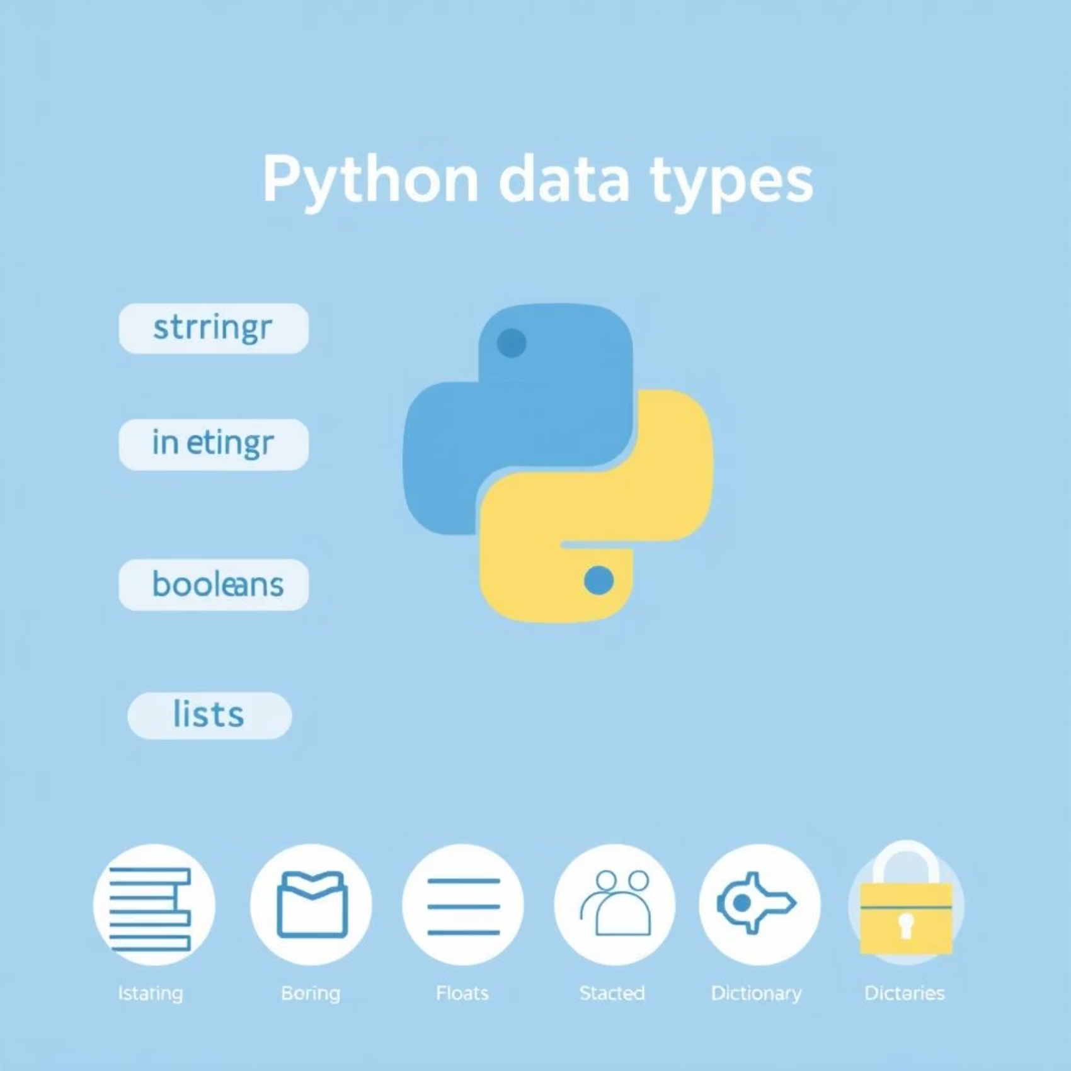
What are Data Types?
In Python, data types are essential classifications that categorize different kinds of data values. They provide a blueprint for how Python should interpret, store, and interact with the data you use in your programs.
Interpretation: They determine how values are read and understood by the interpreter (e.g., as text, whole numbers, decimal numbers, or true/false statements).
Storage: Data types influence the amount of memory allocated for a variable, optimizing resource usage.
Operations: They dictate which operations (like arithmetic, string concatenation, or logical comparisons) can be performed on the data without causing errors.
Validation: Proper use of data types helps maintain data integrity and prevents unexpected behavior or type-related errors in your code.

Slide 4

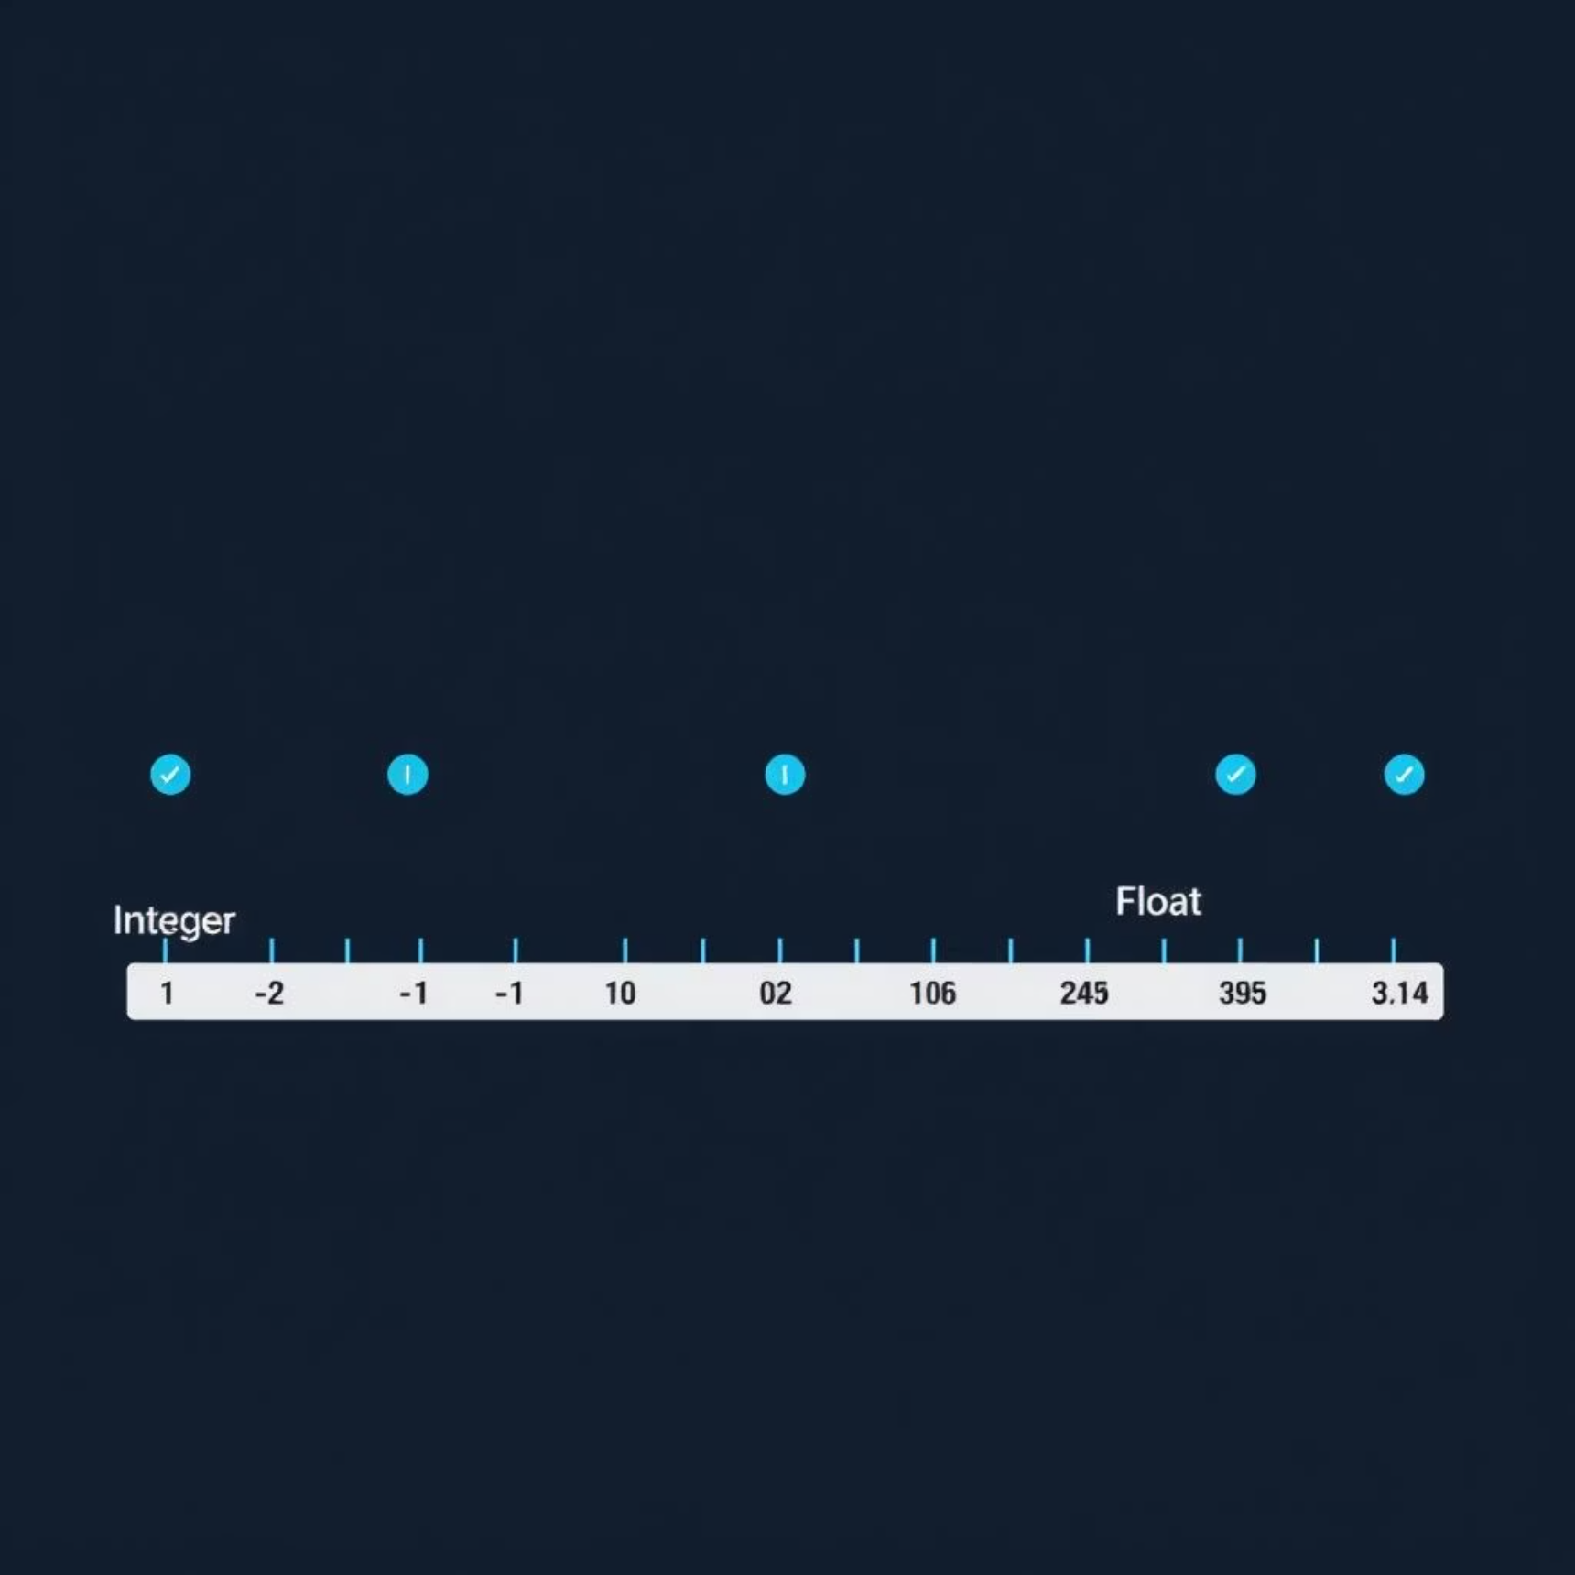
Numbers: Integers & Floats
Python handles numerical data through two primary types: Integers and Floats. Understanding their differences is crucial for accurate calculations and data manipulation.
Integers (int)
Integers represent whole numbers, positive or negative, without decimal points. They have unlimited precision, meaning they can store arbitrarily large or small whole numbers.
x = 42temperature = -15year = 2024
Floats (float)
Floats represent real numbers, including those with fractional parts. They are stored using a fixed amount of memory, which means they have limited precision, potentially leading to small rounding errors in very complex calculations.
y = 3.14price = 19.99pi_approx = 22/7

Slide 5
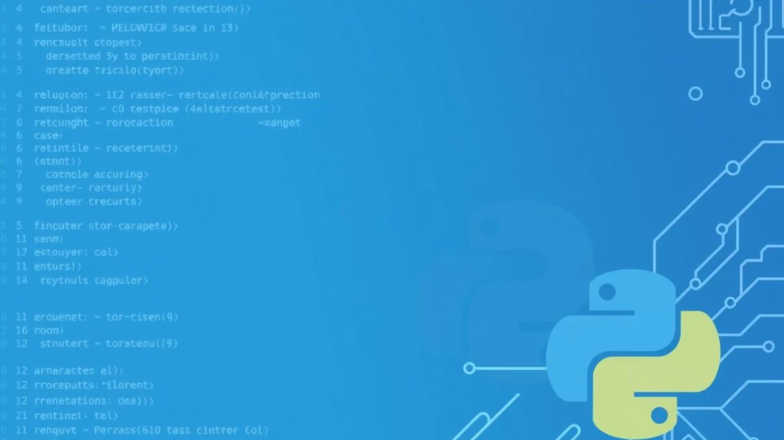

Strings: Text Data
Strings are fundamental data types used to represent text. In Python, a string is a sequence of characters enclosed in single, double, or triple quotes. They are immutable, meaning once created, their content cannot be changed.
Creating Strings
name = "Python"message = 'Hello World!'multiline_text = """This is amulti-line string."""
Key String Operations
Concatenation: Joining two or more strings together.
Slicing: Extracting a portion (substring) of a string.
Length: Determining the number of characters in a string.
# Concatenationgreeting = "Hello" + " " + "Python" # "Hello Python"# Slicingword = "Programming"first_three = word[0:3] # "Pro"last_four = word[-4:] # "ging"

Slide 6

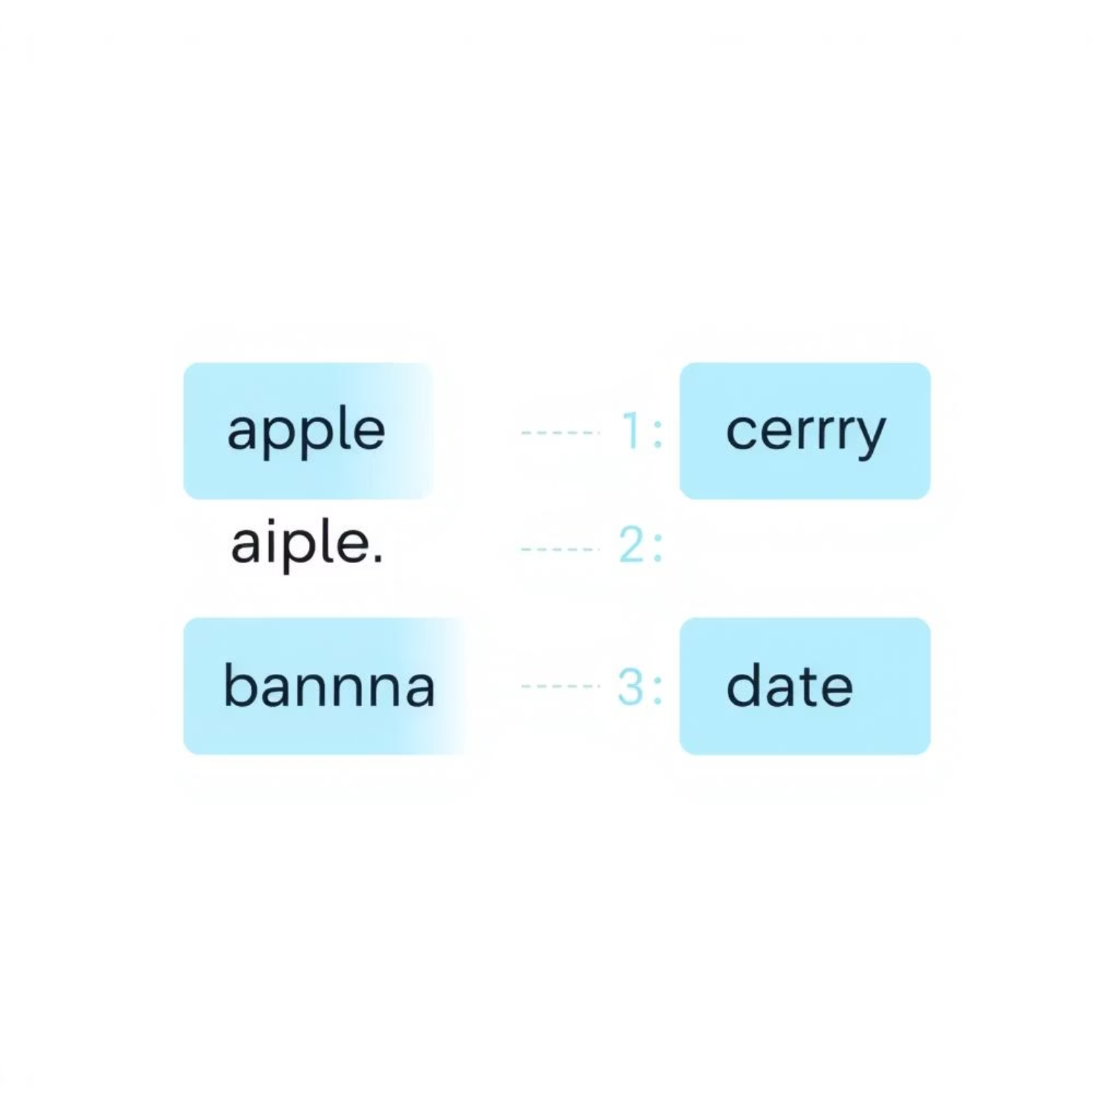
Lists: Ordered Collections
Lists are versatile, ordered, and mutable collections that can hold items of various data types. They are fundamental for storing sequences of data in Python.
What is a List?
Unlike strings, lists are mutable, meaning their contents can be changed after creation. Each item in a list has an index, starting from 0, which defines its position.
# Example of a listfruits = ["apple", "banana", "cherry", "date"]numbers = [1, 2, 3, 4]mixed_list = ["text", 123, 3.14, True]
Key List Operations
Indexing: Access individual elements using their position.
Slicing: Extract a portion of the list (a sub-list).
Methods: Modify the list directly (e.g., adding, removing, or reordering elements).
# Indexingfirst_fruit = fruits[0] # "apple"last_fruit = fruits[-1] # "date"# Slicingsome_fruits = fruits[1:3] # ["banana", "cherry"]# Methodsfruits.append("elderberry") # Adds to endfruits.remove("apple") # Removes "apple"numbers.sort() # Sorts the list

Slide 7

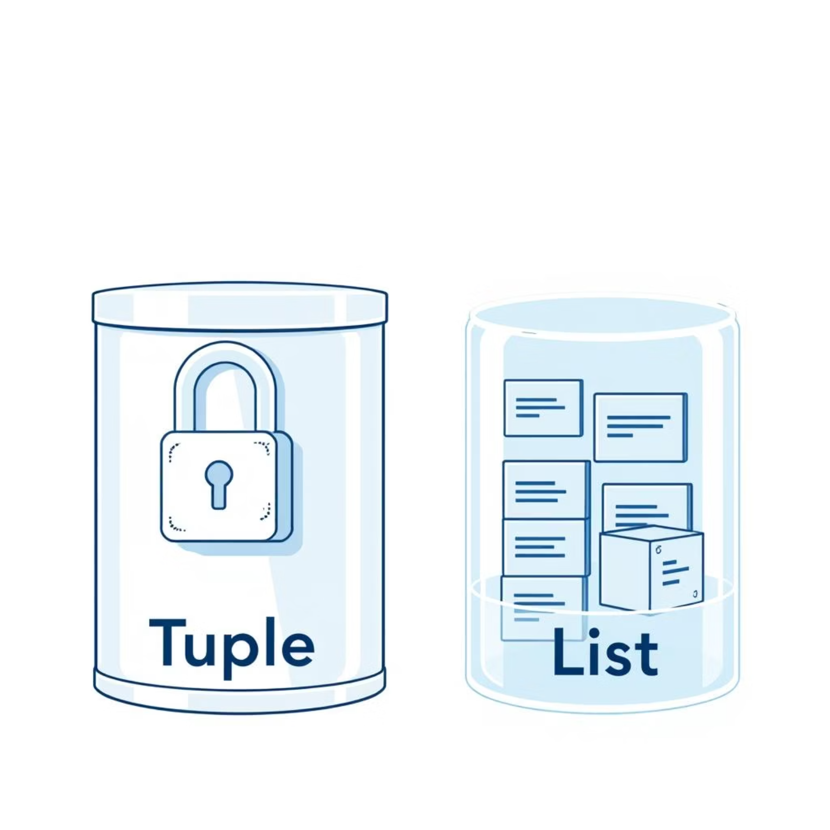
Tuples: Immutable Sequences
Tuples are ordered collections of items, very similar to lists. The key distinction is their immutability: once a tuple is created, its elements cannot be changed, added, or removed. This makes tuples ideal for data that should remain constant throughout a program's execution.
Defining Tuples
Tuples are defined using parentheses () and elements are separated by commas. They can hold items of various data types, just like lists.
coordinates = (10, 20)colors = ("red", "green", "blue")mixed_tuple = ("Python", 3.14, True)
When to Use Tuples
Fixed Collections: For data that should not change, such as configuration settings or database records.
Dictionary Keys: Tuples can be used as keys in dictionaries because of their immutability (lists cannot).
Function Returns: Functions often return multiple values as a tuple, which can then be unpacked.
Performance: Tuples are generally more memory efficient and slightly faster than lists for iteration over elements.
This immutability ensures data integrity and makes tuples hashable, allowing them to be used in contexts where an unchanging value is required.
Tuple Unpacking
A convenient feature allowing you to assign elements of a tuple to multiple variables at once.
point = (5, 10)x, y = point # x is 5, y is 10name, age, city = ("Alice", 30, "New York")

Slide 8
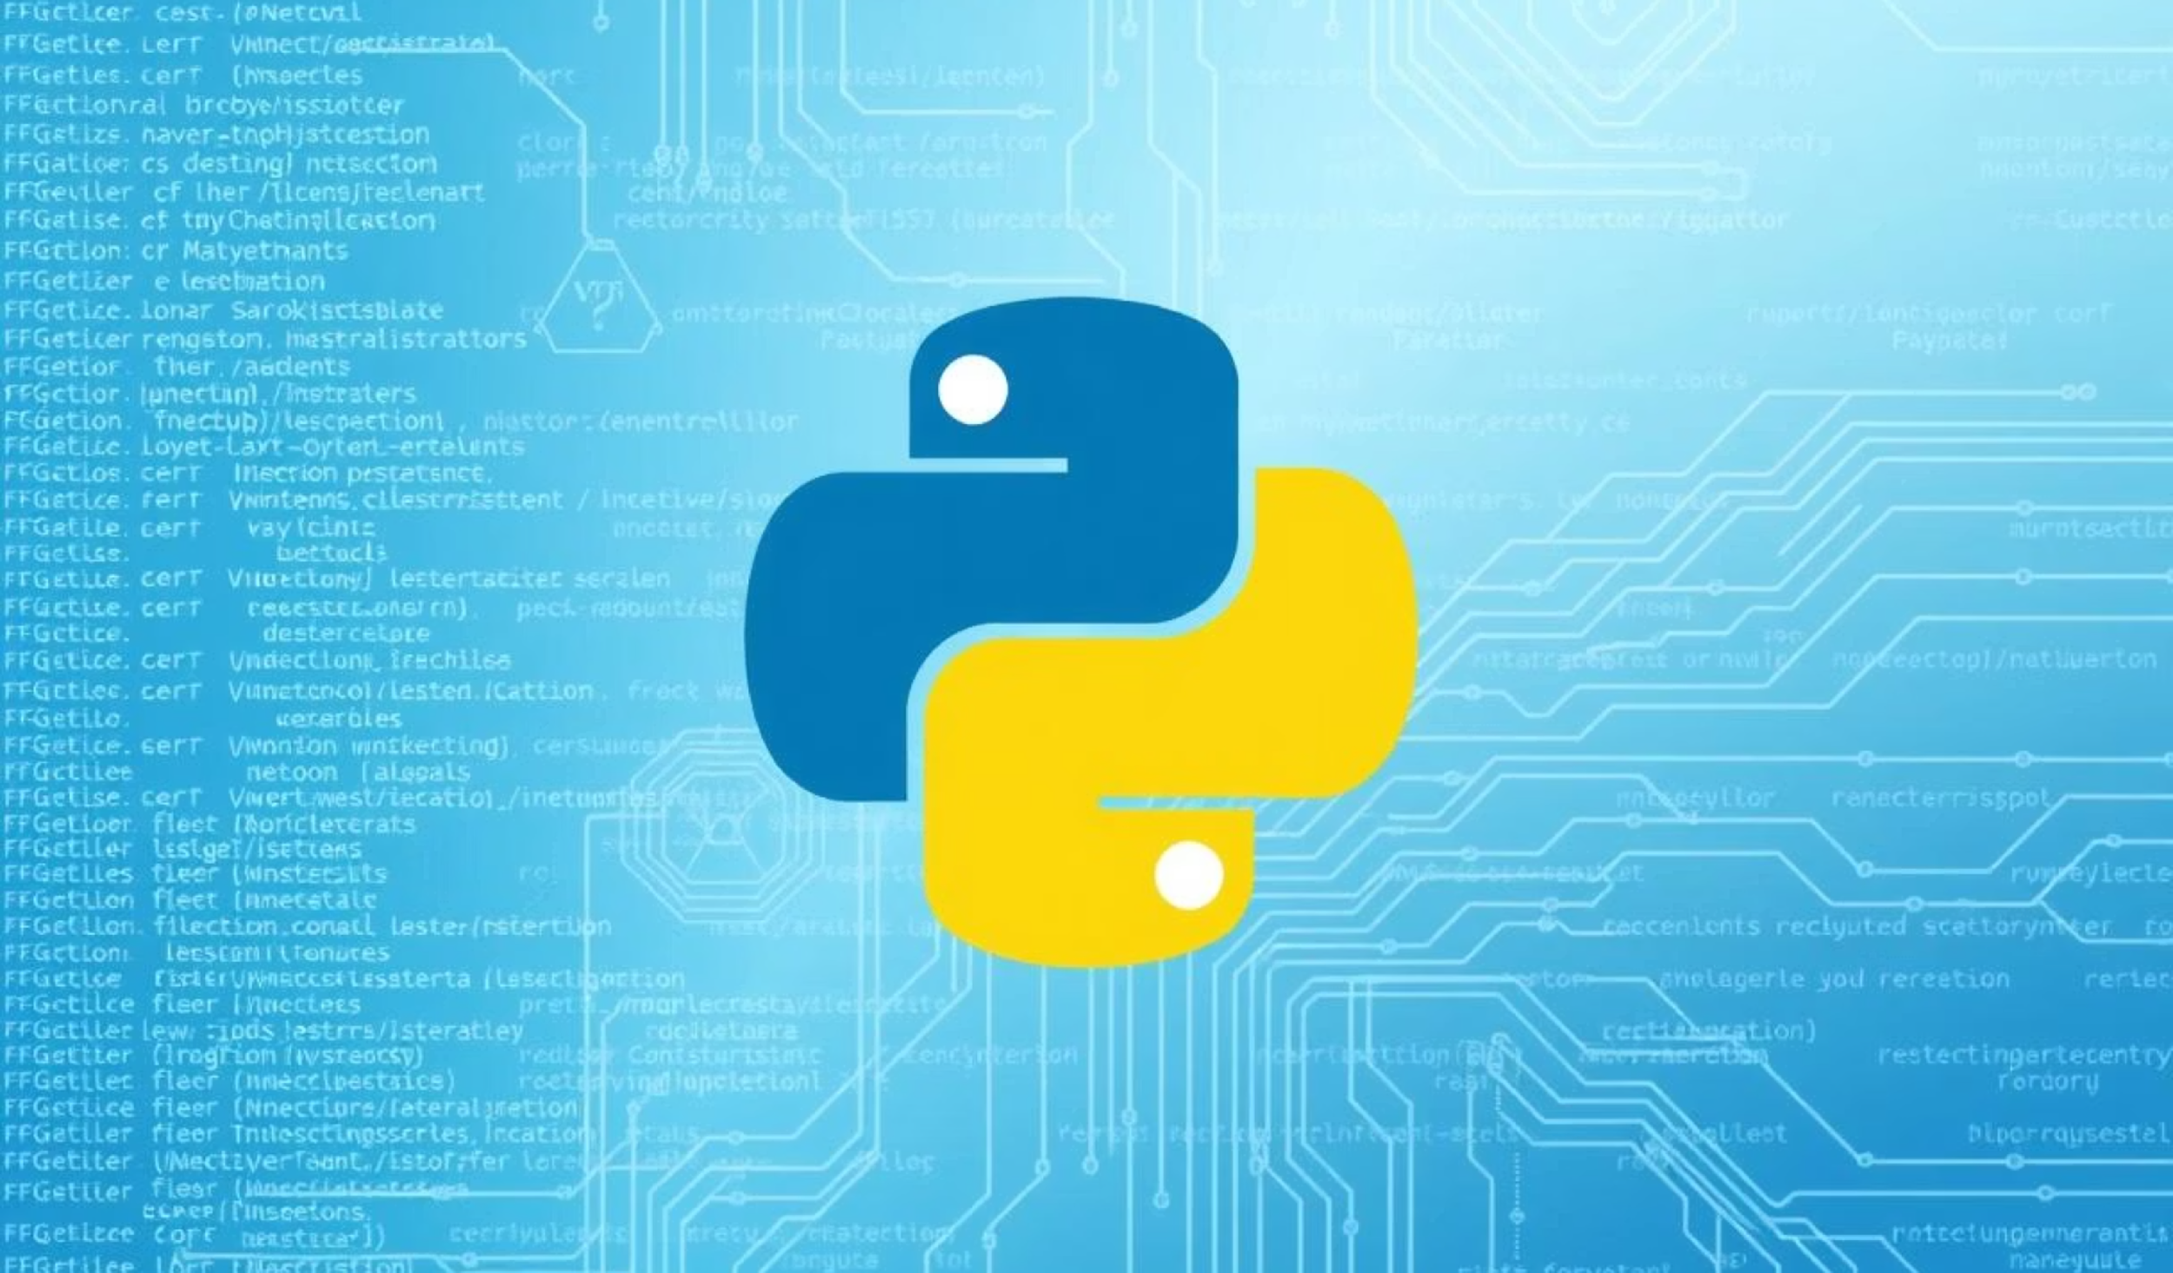
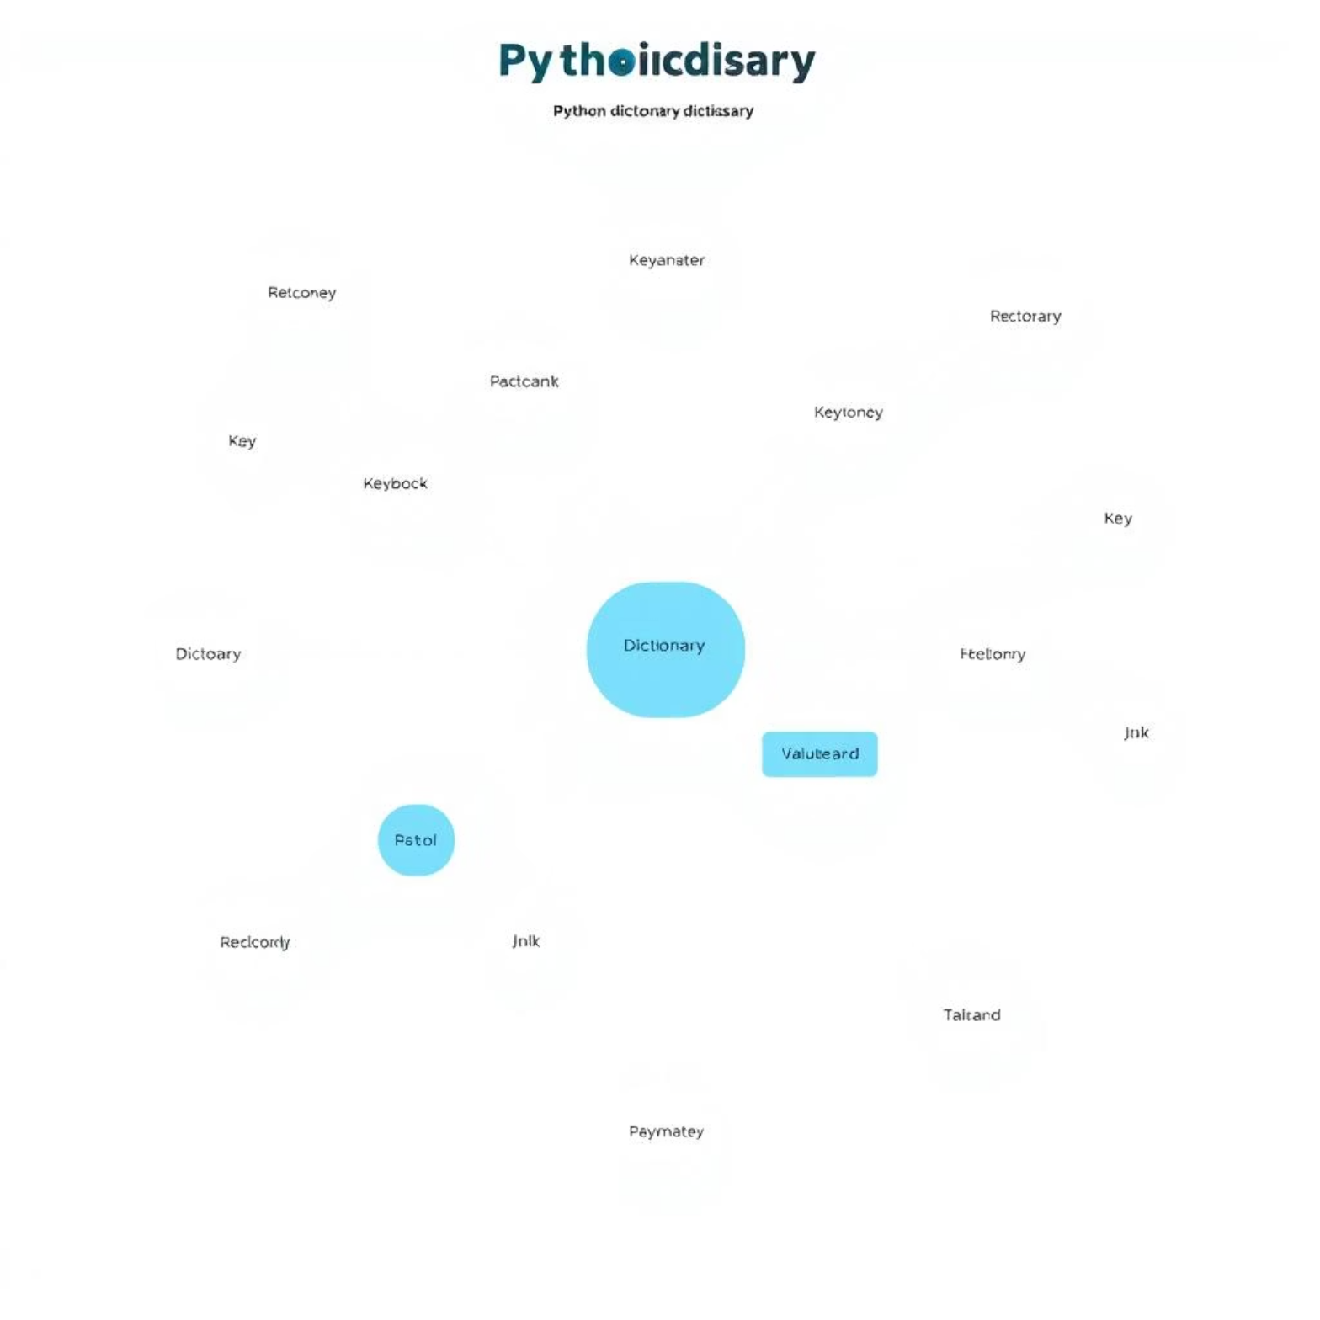
Dictionaries: Key-Value Pairs
Dictionaries are Python's highly flexible and powerful data structures for storing data in key-value pairs. They are unordered and mutable, allowing for efficient retrieval and modification of data.
What is a Dictionary?
Each value in a dictionary is associated with a unique key, which acts as its identifier. Keys must be immutable (like strings or tuples), while values can be any data type.
# Example of a dictionarystudent = { "name": "John", "age": 20, "grade": "A"}
Key Dictionary Operations
Accessing Values: Retrieve a value using its corresponding key.
Adding/Updating: Add new key-value pairs or change existing values.
Removing: Delete key-value pairs from the dictionary.
# Accessingstudent_name = student["name"] # "John"# Adding/Updatingstudent["major"] = "Computer Science"student["age"] = 21 # Updates age# Removingdel student["grade"]
Dictionaries allow for quick data lookups using distinct keys, making them ideal for mapping information like user profiles, configuration settings, or data records.

Slide 9
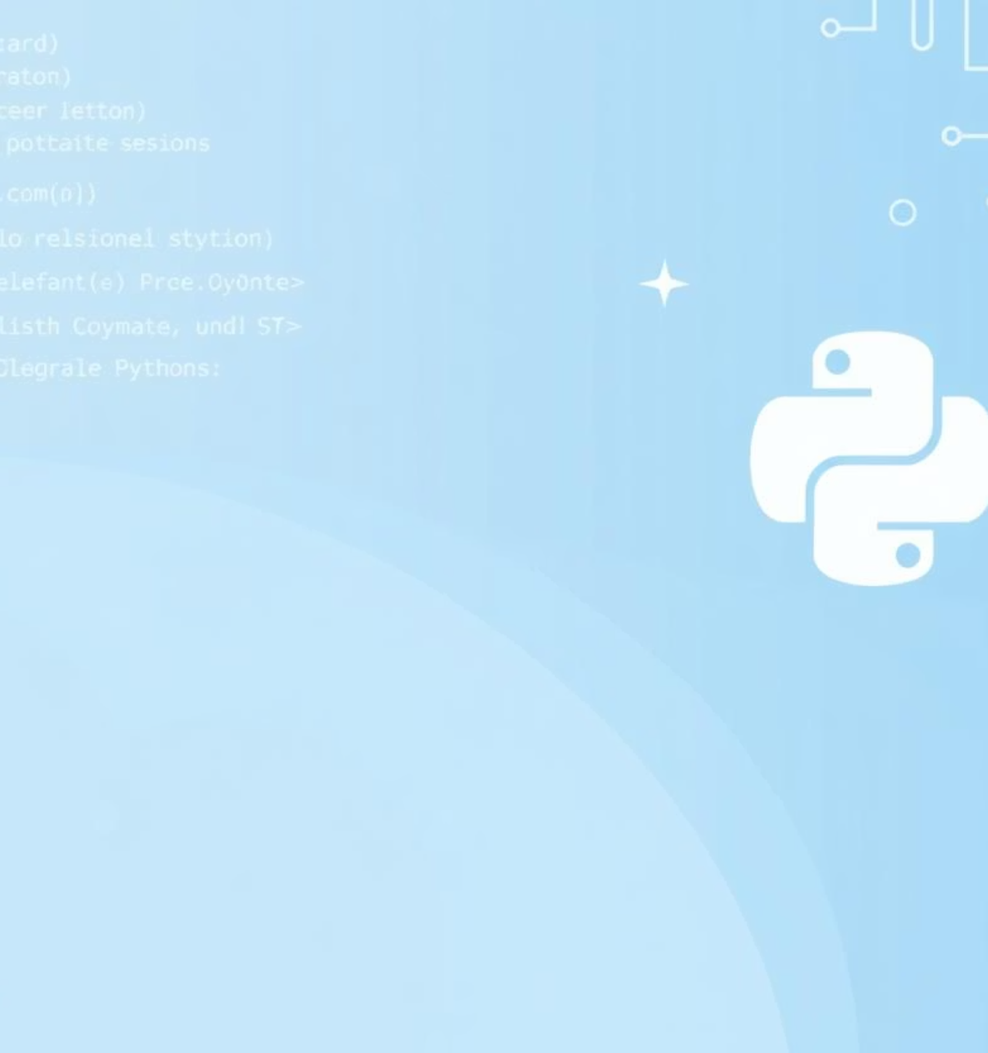


Sets & Booleans: Unique Values & Logic
Python provides specialized data types for managing unique collections and for handling logical conditions. Understanding Sets and Booleans is crucial for data integrity and control flow.
Sets: Unordered Collections of Unique Items
Sets are unordered collections of unique elements. This means a set cannot have duplicate items. They are mutable, allowing items to be added or removed.
# Creating a Setcolors = {"red", "green", "blue"}numbers = {1, 2, 3, 2, 1} # Becomes {1, 2, 3}
Key Set Operations
Union (|): Combines all unique elements from both sets.
Intersection (&): Returns elements common to both sets.
Difference (-): Returns elements in the first set but not in the second.
A = {1, 2, 3, 4}B = {3, 4, 5, 6}union_set = A | B # {1, 2, 3, 4, 5, 6}intersection_set = A & B # {3, 4}difference_set = A - B # {1, 2}
Sets are highly efficient for membership testing and for eliminating duplicate entries from other collections.
Booleans: The Foundation of Logic
Booleans represent one of two values: True or False. They are fundamental for controlling the flow of a program through conditional statements and loops.
# Boolean valuesis_active = Truehas_permission = False# Comparison resulting in a Booleanis_greater = (10 > 5) # Trueis_equal = (5 == 5) # True
Boolean Operations
AND (and): True if both operands are True.
OR (or): True if at least one operand is True.
NOT (not): Inverts the Boolean value.
result_and = True and False # Falseresult_or = True or False # Trueresult_not = not True # False
Booleans are crucial for decision-making in programming, enabling code to execute different paths based on conditions.

Slide 10

Data Types: Summary & Comparison
Understanding Python's core data types is fundamental to writing efficient, robust, and readable code. Each type serves a distinct purpose, offering unique characteristics regarding mutability, order, and optimal use cases.
Integer (int)
Immutable
N/A
Whole numbers, counting
Float (float)
Immutable
N/A
Decimal numbers, scientific calculations
String (str)
Immutable
Ordered
Text data, sequences of characters
List (list)
Mutable
Ordered
Collections of items that can change, general-purpose sequences
Tuple (tuple)
Immutable
Ordered
Fixed collections of related items, dictionary keys
Dictionary (dict)
Mutable
Unordered
Storing data in key-value pairs, fast lookups
Set (set)
Mutable
Unordered
Storing unique items, membership testing, mathematical set operations
Boolean (bool)
Immutable
N/A
Logical operations, conditional statements (True/False)
Choosing the correct data type for your variables and collections is a critical design decision. It impacts not only the efficiency and performance of your Python programs but also their readability and maintainability. A deep understanding of these fundamental building blocks empowers you to write more robust and effective code.

